Slide 1
THE COMPUTER
Week 3

Slide 2
THE COMPUTER
The Computer is ever changing with new technology.
However it is not apparent (clear) that our knowledge of design is improving!

Slide 3
THE COMPUTER
Today’s lecture will cover aspects of:
  1.Text Entry Devices
  2.Display Devices
  3.Memory
  4.Paper: Printing & Scanning

Slide 4
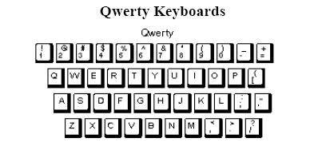
Text Entry Devices
Keyboards
  The main and preferred choice for input to a computer.

Slide 5
Text Entry Devices
Non-optimal arrangement of keys.
However due to widespread acceptance of qwerty unlikely to ever be replaced widely.

Slide 6
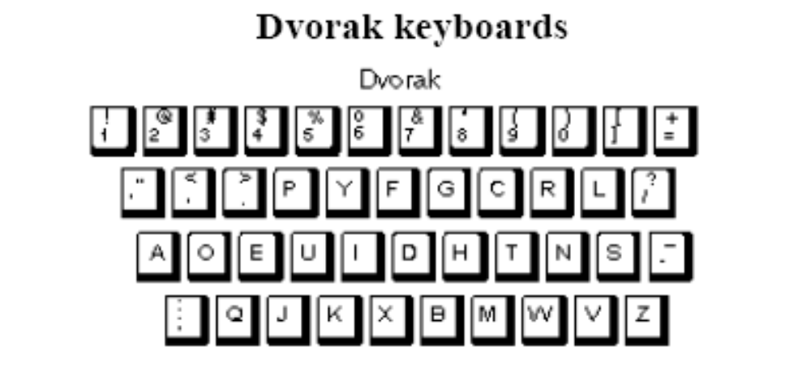
Text Entry Devices
Provides a better ratio of usage between both hands (56% for right-hand) and common letter collocations are grouped together.

Slide 7
Text Entry Devices
Pointing
  Pointing involves moving a cursor on the screen to perform tasks or move objects.
  Common today on all computers but originally used solely in CAD.
  Typically uses a mouse to move the cursor (ease of use & small)

Slide 8
Text Entry Devices
Other devices:
  Trackball: like an upside down mouse/useful on lap tops.
  Joystick: good for games
  Touch screens: good for public access

Slide 9
Visual Display Unit
Visual Display Guidelines
  Avoid overfilling screen.
  Use upper right corner for important messages.
  Use different letter fonts & color to distinguish different parts.

Slide 10
Visual Display Units
  Design layout so that eye follows content. (Left to right/Up to down).
  Use Blinking to attract attention - but avoid overuse.

Slide 11
Paper: Printing & Scanning
The paperless Office (a dream)
  All information held & displayed via computer screen & avoid costly floor space for files & save trees.
  The problem is that people still prefer to work with paper.

Slide 12
Paper: Printing & Scanning
Printers
  1 A4 page at 300 dpi can contain 8 megabytes of information (ten minutes to transfer down a serial cable).
  Page Description Languages (PDL e.g. PostScript & PDF)

Slide 13
Paper: Printing & Scanning
Scanners & OCRs
  Scanning creates a bit map of the page - this is an inefficient method of storage.
  Optical Character Recognition allows Compression/Processing

Slide 14
Memory
Primary Storage (Short Term Memory)
  Registers on the computer chip
  Random Access Memory (Fast: 10 Mbytes per second)
  Low capacity: 8 Mbytes (typically)
  Most is volatile but a small amount will be non-volatile (though this ratio is changing).

Slide 15
Memory
Secondary Storage (Long Term Memory)
  Slower access: 10 ms to locate information/100 kilobytes per sec.
  Floppy discs (1.4 Mbytes)
  Hard discs (30 Gbytes (and climbing))
  CD-Roms (largely read only) Several Gbytes

Slide 16
Memory
RAM is now usually big enough for most single applications.
Multi-tasking however is common
The difference in access times and capacities between primary and secondary memories causes a bottleneck.

Slide 17
Memory
Can be avoided by clever memory management: lazy swapping and preempting paging requests.
Applications fill the memory available. (e.g. increased use of video/more human-based applications)

